Slide 1

ECO
2018 WIC
9해조
MON EY
Obtaining Eco-Money through the use of Eco-Tong
Eco-Money for SookMyung students
through utilizing Eco-Tong in and outside the campus

Slide 2

Agenda
Introduction of IoT waste bin to resolve/alleviate street waste problems
Problem
Solution
Design
Offerings & Benefits
Demo Video

Slide 3


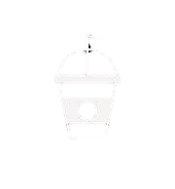




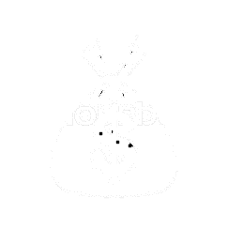

Problems
Street Waste
Too many take-out cups are disposed with drinks inside, especially at bus stops
There is insufficient supply of waste bins in the street with no provision of bin for food or beverages
Over 90%
3~4bn disposal
More than 90% of overall waste are take-out cups
Take-out cup disposals account for 3~4 billion
Reconsideration of UI/UX is required in order to improve usage of street waste bins
Despite publications on the street waste problems, no or little improvement is made
Cleaning distress
23bn used annually
Requires cleaners to carry a bucket to collect cups containing drinks
Take-out cup use in Korea is around 23 billion every year
Social costs associated with street waste problems are high, indicating the need for resolving the issues

Slide 4

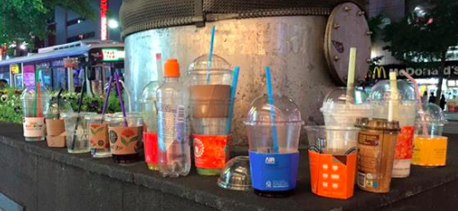
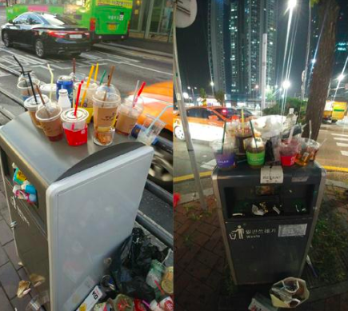
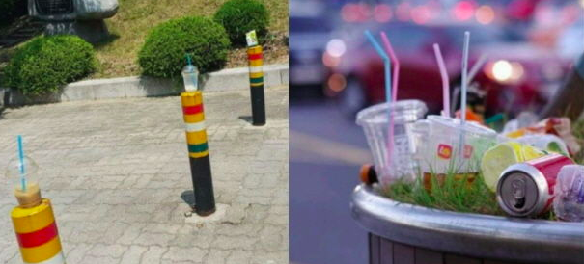
Problems cont.

Slide 5
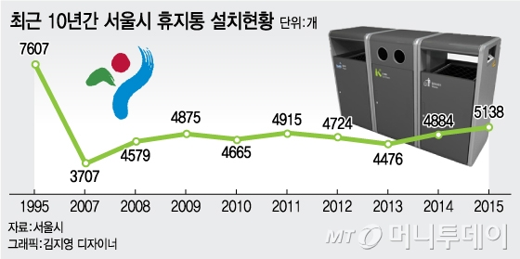
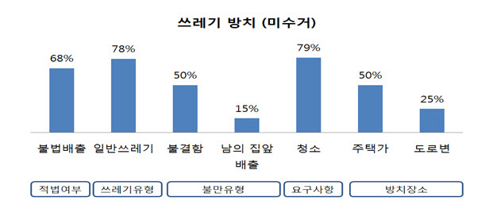
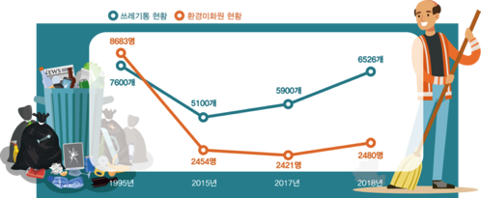
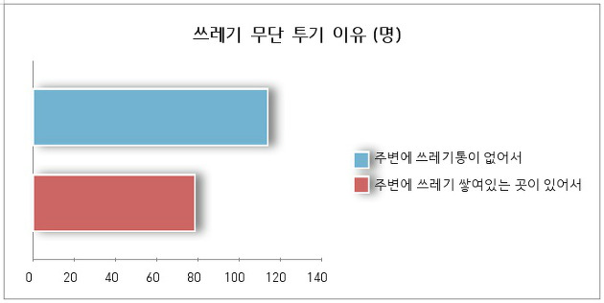
Problems cont.

Slide 6
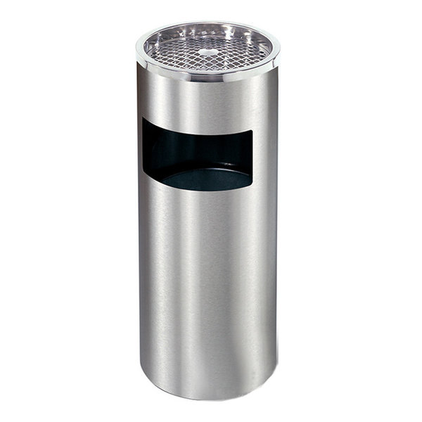
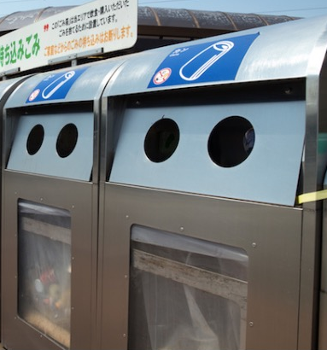


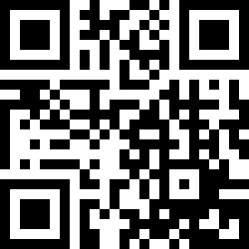
Solution
Eco-Tong
The Eco-Tong is accompanied with the bin for drinks, so that user can empty the cup before disposal.
The design for recyclable materials such as paper and plastics is based on the existing waste bins. QR code is attached to the bin, that enables to locate the bin on the mobile application.
A weight sensor is attached to the Eco-Tong, so that the user is only rewarded when take-out cups are disposed without any drinks inside.
For user convenience and efficient waste collection, it was deemed useful to make it transparent at nearly-full level.
The Eco-Tong pair displays enhanced connectivity through Bluetooth function and increased UI/UX through attached QR code.

Slide 7
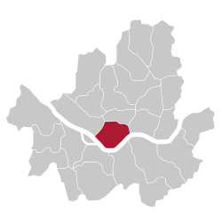






Solution
Proposed Solution
EcoMoney
User
Litter
Pilot in Yongsan-gu
Mobile App
Transmit
Eco-Tong
When user litters residual drinks and the cup in the installed recycle bin, she obtains EcoMoney over the mobile application. With the provided credits, the user can enjoy same benefits as her favorite membership points

Slide 8
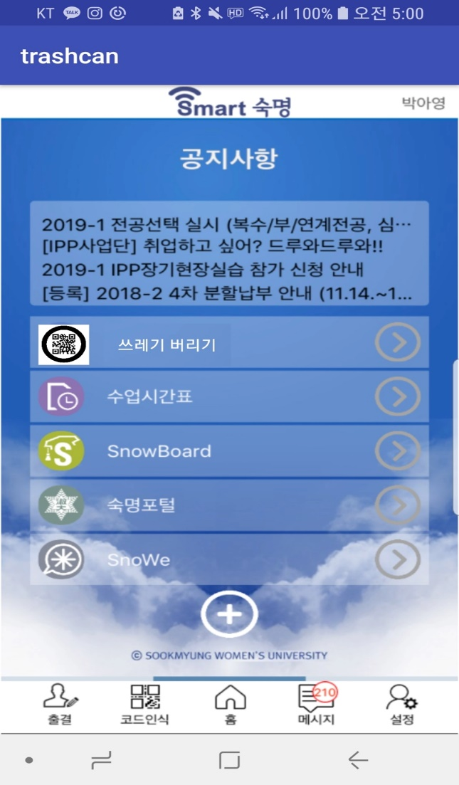
Design
Our Service
Through added feature on Smart Sookmyung application, students can obtain Eco-Money from using Eco-Tong
The obtained Eco-Money can be further utilized in any chosen form of T-money mileage, Shinhan S-point or mobile phone carriers’ membership points
Starting from Sookmyung Women’s University and Yongsangu, Eco-Tong will be widely installed in many parts of Seoul City
This service will be provided through a separate application called ‘EcoMoney’, which can be downloaded on either Appstore or Playstore

Slide 9







Offerings & Benefits
Boosting Eco-friendly waste culture
Contribution to waste reduce
Receiving Eco-Money as a reward each time
In order to encourage frequent use of Eco-Tong, 50 Eco points will be given followed by appropriate litter. To prevent abuses, maximum reward per day will be limited to 500 points. Through collaborating with other businesses and institutions, Eco-Money will be converted into other forms of points to boost UX.
Eco-Money equivalent to other mileages and points
Bonus points are to be rewarded on a random basis

Slide 10
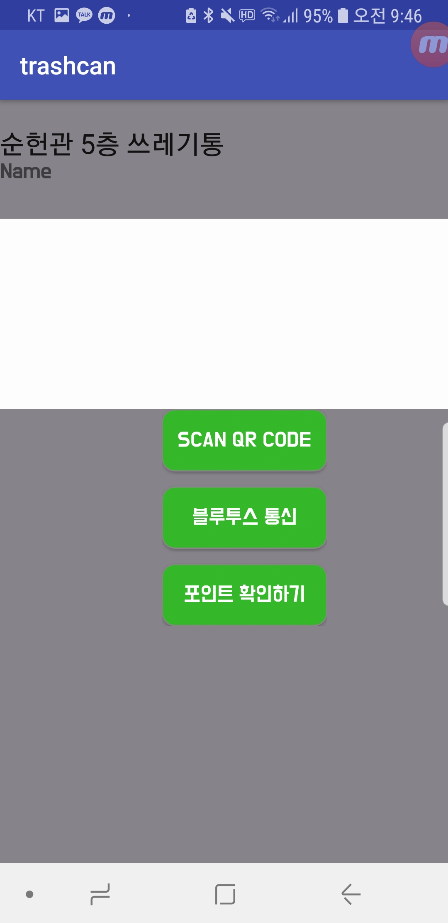
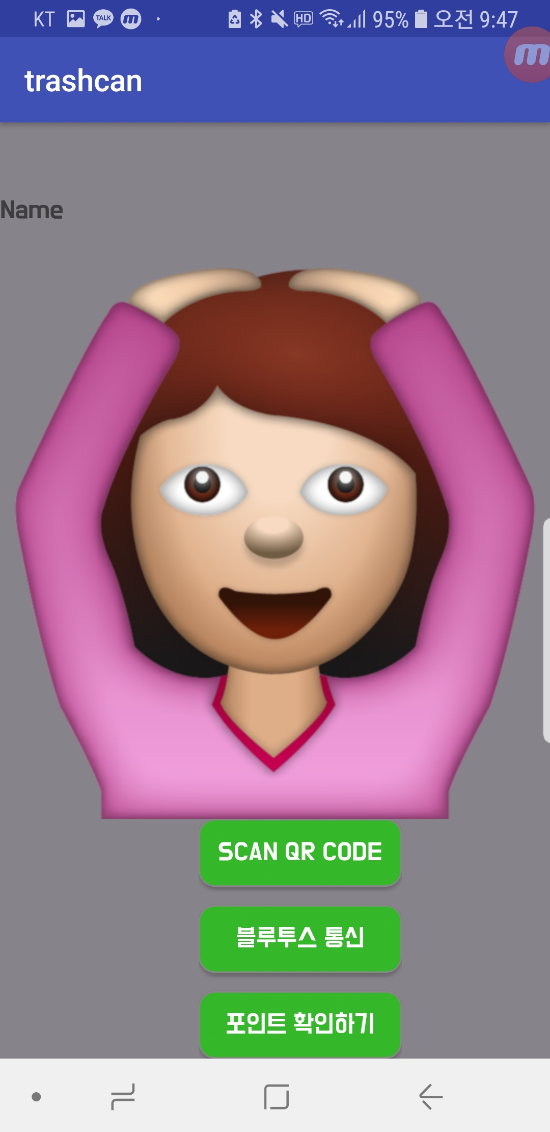
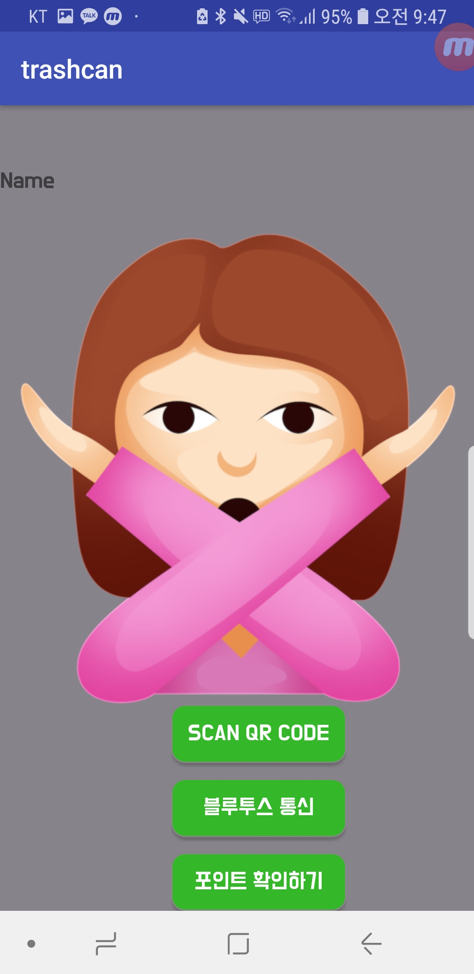
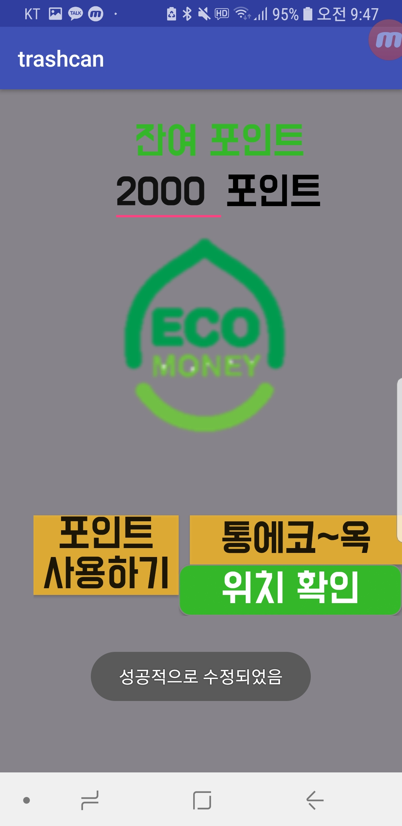
Demo

Slide 11
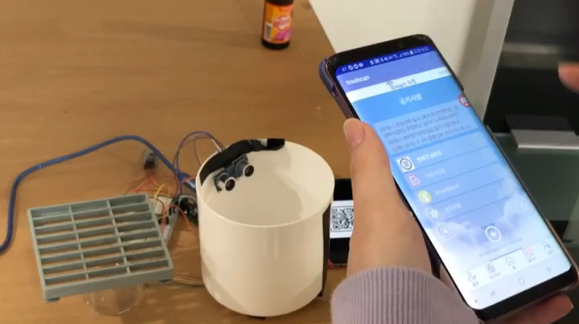
Demo

